Slide 1

Week 04 : Lecture 07

Slide 2

Lecture 07 :
Quiz 01 graded and marks sheet uploaded.
Quiz 01 solution will be posted on group.
Practice sheet 01 : posted on group
Bring lab manual + laptops in next class.Mandatory
Tentative Date for Mid : mid of November
Assig 01 : Next class I.A

Slide 3
Intro to Assembly Language :

Slide 4

Book reading : Supplementary !!!
Topics covered in this lecture are from these texts.
Assembly Language 6th edition,Kip Irvine
Chapter 1 read topic 1.1Welcome to AL language
Chapter 3 Assembly Language fundamentals FULL CHAPTER reading recommended.

Slide 5
Today’s lecture :
Overview and introduction
Basic Elements of Assembly Language
Sample First Program : Dissection
Data Allocation Directives
Symbolic Constants
Data Transfer Instructions
Arithmetic Instructions
Basic Operand Types

Slide 6

Why Assembly language(AL) !!!
Hardware Control is easy.
Device driver
Embedded system development.
Microcontroller/Microprocessor based systems
Operating systems
x86 based OS : MikeOS,MenuetOS
Game development
Mix of Assembly and high level languages
Assembly lang. programmers needs to know comp. architecture as well as operating system(OS).

Slide 7
Table Software Hierarchy Levels.

Slide 8
Essential Tools for AL:
An assembler is a program that converts source-code programs into a machine language (object file).
Popular assembler:
MASM
TASM
NASM
A linker joins together two or more object files and produces a single executable file.
For example : link32.exe
A debugger loads an executable program, displays the source code, and lets the programmer step through the program one instruction at a time, and display and modify memory.

Slide 9
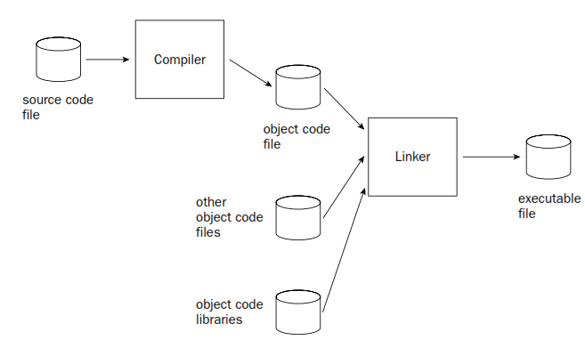
How program in HLL works : Say C++

Slide 10
Assemble-Link-Execute Cycle

Slide 11
Files Created by the Assembler and Linker

Slide 12
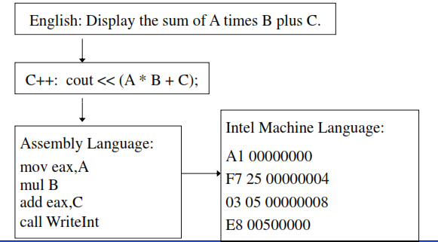
Translating languages : Comparison

Slide 13

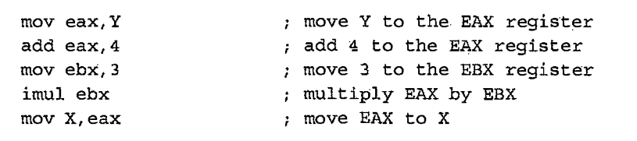
How assembly and C++ relates !!!
Is assembly language portable ?Explain.

Slide 14

Your Turn : Hands on first AL code
Write your first assembly language program for following :
X = ( Y * 4 ) + 3
AL Code :

Slide 15
Defining Constants:
Use a radix symbol (suffix) to select binary, octal, decimal, or hexadecimal
6A15h ; hexadecimal
32q or 32o ; octal
1011b ; binary
35d ; decimal (default)
Symbolic constants:
COUNT = 25
ROWS = 10
tablePos = ROWS * 5
Constant Expressions:
4 * 20
-3 * 4 / 6
ROWS - 3 ;ROWS is a constant
Strings Constants:
‘a’ ; character data
‘Abc’ ; string data

Slide 16
Explanation through an Example:
Chapter 3 , AL fundamentals , 3.2 Example

Slide 17
Starting with an Example :
TITLE Add and Subtract (AddSub.asm)
; Adds and subtracts three 32-bit integers
; (10000h + 40000h + 20000h)
INCLUDE Irvine32.inc
.code
main PROC
mov eax,10000h ; EAX = 10000h
add eax,40000h ; EAX = 50000h
sub eax,20000h ; EAX = 30000h
call DumpRegs ; display registers
exit
main ENDP
END main
Title
Include file
Code section

Slide 18
Reserved Words, Directives
TITLE Add and …
; Adds and subtracts
; (10000h + …
INCLUDE Irvine32.inc
.code
main PROC
mov eax,10000h
add eax,40000h
sub eax,20000h
call DumpRegs
exit
main ENDP
END main
TITLE:
Define program listing title
Reserved word of directive
Reserved words
Instruction mnemonics, directives, operators, predefined symbols
See MASM reference in Appendix of book
Directives:
Commands for assembler
e.g TITLE , INCLUDE
Assembly is case insensitive

Slide 19
Directive Vs Instruction :
Directives: tells assembler what to do
Commands that are recognized and acted upon by the assembler, e.g. declare code, data areas, select memory model, declare procedures, etc.
Not part of the Intel instruction set
Different assemblers have different directives
Instructions: tells CPU what to do
Assembled into machine code by assembler
Executed at runtime by the CPU
Member of the Intel instruction set
Format: LABEL (option), Mnemonic, Operands, Comment

Slide 20
Comments
TITLE Add and …
; Adds and subtracts
; (10000h + …
INCLUDE Irvine32.inc
.code
main PROC
mov eax,10000h
add eax,40000h
sub eax,20000h
call DumpRegs
exit
main ENDP
END main
Single-line comments
begin with semicolon (;)
Multi-line comments
begin with COMMENT directive and a programmer-chosen character, end with the same character, e.g.
COMMENT !
I am a multiline
comment.
!

Slide 21
Include Files
INCLUDE directive:
Copies necessary definitions and setup information from a text file named Irvine32.inc, located in the assembler’s INCLUDE directory.
Example
DumpRegs
clrscr
TITLE Add and …
; Adds and subtracts
; (10000h + …
INCLUDE Irvine32.inc
.code
main PROC
mov eax,10000h
add eax,40000h
sub eax,20000h
call DumpRegs
exit
main ENDP
END main

Slide 22
Code Segment
TITLE Add and …
; Adds and subtracts
; (10000h + …
INCLUDE Irvine32.inc
.code
main PROC
mov eax,10000h
add eax,40000h
sub eax,20000h
call DumpRegs
exit
main ENDP
END main
.code directive:
Marks the beginning of the code segment, where all executable statements in a program are located

Slide 23
Procedure Definition
TITLE Add and …
; Adds and subtracts
; (10000h + …
INCLUDE Irvine32.inc
.code
main PROC
mov eax,10000h
add eax,40000h
sub eax,20000h
call DumpRegs
exit
main ENDP
END main
Procedure Syntax:
[label] PROC
[label] ENDP
Label:
Place markers: marks the address (offset) of code and data
Assigned a numeric address by assembler
Follow identifier rules
Code label: target of jump and loop instructions, e.g. L1:

Slide 24
Identifiers
TITLE Add and …
; Adds and subtracts
; (10000h + …
INCLUDE Irvine32.inc
.code
main PROC
mov eax,10000h
add eax,40000h
sub eax,20000h
call DumpRegs
exit
main ENDP
END main
Identifiers:
A programmer-chosen name to identify a variable, a constant, a procedure, or a code label
1-247 characters, including digits
not case sensitive
first character must be a letter(A..Z,a…z),underscore(_), @, ?, or $
Identifier could not be a reserved word.

Slide 25
Instructions
TITLE Add and …
; Adds and subtracts
; (10000h + …
INCLUDE Irvine32.inc
.code
main PROC
mov eax,10000h
add eax,40000h
sub eax,20000h
call DumpRegs
exit
main ENDP
END main
Syntax:
[label:] mnemonic operand(s) [;comment]
Instruction mnemonics:
help to memorize
examples: MOV, ADD, SUB, MUL, INC, DEC
Operands:
constant
constant expression
register
memory (data label, register)
Destination
operand
Source
operand
immediate values

Slide 26
I/O
TITLE Add and …
; Adds and subtracts
; (10000h + …
INCLUDE Irvine32.inc
.code
main PROC
mov eax,10000h
add eax,40000h
sub eax,20000h
call DumpRegs
exit
main ENDP
END main
Not easy, if program by ourselves
Will use the library provided by the author
Two steps:
Include the library (Irvine32.inc) in your code
Call the subroutines
call DumpRegs:
Calls the procedure to displays current values of processor registers

Slide 27
Remaining
TITLE Add and …
; Adds and subtracts
; (10000h + …
INCLUDE Irvine32.inc
.code
main PROC
mov eax,10000h
add eax,40000h
sub eax,20000h
call DumpRegs
exit
main ENDP
END main
exit:
Halts the program
Not a MSAM keyword, but a command defined in Irvine32.inc
END main:
Marks the last line of the program to be assembled.
Identifies the name of the program’s startup procedure

Slide 28
Example Program Output
Program output, showing registers and flags
EAX=00030000 EBX=7FFDF000 ECX=00000101 EDX=FFFFFFFF
ESI=00000000 EDI=00000000 EBP=0012FFF0 ESP=0012FFC4
EIP=00401024 EFL=00000206 CF=0 SF=0 ZF=0 OF=0

Slide 29
Alternative Version of AddSub
TITLE Add and Subtract (AddSubAlt.asm)
; adds and subtracts 32-bit integers
.386
.MODEL flat,stdcall
.STACK 4096
ExitProcess PROTO, dwExitCode:DWORD
DumpRegs PROTO
.code
main PROC
mov eax,10000h ; EAX = 10000h
add eax,40000h ; EAX = 50000h
sub eax,20000h ; EAX = 30000h
call DumpRegs
INVOKE ExitProcess,0
main ENDP
END main

Slide 30
Explanations
.386 directive:
Minimum processor required for this code.
.MODEL directive:
Generate code for protected mode program
Stdcall: enable calling of Windows functions
PROTO directives:
Prototypes for procedures
ExitProcess: Windows function to halt process
INVOKE directive:
Calls a procedure or function
Calls ExitProcess and passes it with a return code of zero

Slide 31
Suggested Program Template
TITLE Program Template (Template.asm)
; Program Description:
; Author:
; Creation Date:
; Revisions:
; Date: Modified by:
INCLUDE Irvine32.inc
.data
; (insert variables here)
.code
main PROC
; (insert executable instructions here)
exit
main ENDP
; (insert additional procedures here)
END main

